Slide 1

Government

Slide 2
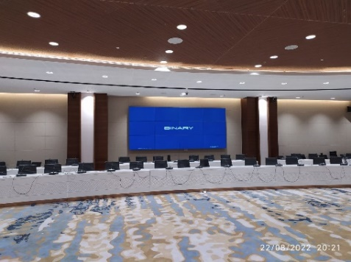

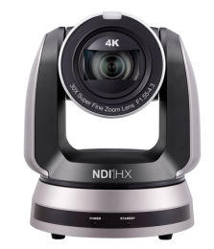
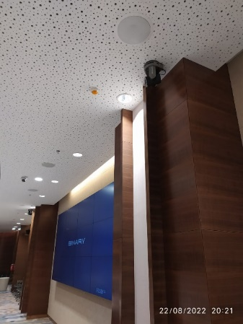
G20 Indonesia 2022
Indonesia
Success Stories
Government
Product: VC-A71PN、VS-KB30
  Country: Indonesia
  City: Jakarta
  Website: https://g20.org/
  Application: International summit conference
  Lumens Product: VC-A71PN PTZ Camera; VS-KB30 Camera Controller
  Along with: BOSCH DICENTIS Conference System
Lumens Products were finalized on demonstrating the solution and showcasing the ease of installation and its use. It was chosen due to its outstanding feature of Recording and Streaming Audio/Video. IP camera controller is also quite handy to control the camera.
Head - IT
Mr. Prashant Sarafdar

Slide 3
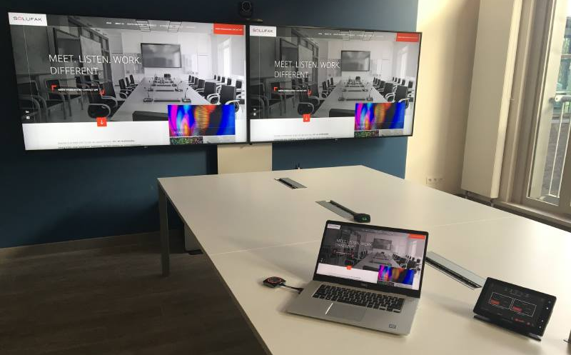

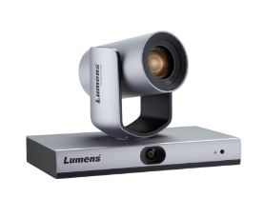
National Railway Company
Belgium
Success Stories
Government
Product: VC-TR1
  Meeting rooms for 4 to 8 people are increasingly popular, often used for departmental meetings, executive meetings, or external video conferencing. In such scenarios, the pain points to be solved include:
  Typically, there is only one HDMI cable in the conference room, and those who want to project to the screen need to change position in order to present.
  Video conferencing requires a USB camera, but USB has a cable length limit, which makes it inconvenient to connect to the laptop.
  Too many wires on the table are not aesthetically pleasing and degrade the image of the company.
  The average conference camera cannot capture everyone in the conference room, and the picture quality is not good.
  If the audio quality in the larger space is poor, it will impact on the meeting experience.
Composite automatic tracking design
Lumens‘ intelligent tracking mode follows a presenter at the front of the room or can automatically frame the picture to ensure that all delegates are in view.
The camera connects to the ClickShare receiver via USB. It does not have to connect directly to a laptop.
Convenient screen sharing
Barco’s ClickShare system allows delegates to start a meeting with ease, hosted on any laptop.
Switch to another user’s screen at the click of a button.
Get rid of cables and quickly share content to the big screen with no re-cabling requried
Simplify sharing and collaboration and increase meeting productivity.
Bring full-room audio coverage to all your unified comms spaces
No matter where people sit in the room, they can be heard by remote participants.
Patented Microphone Mist technology uses virtual microphones to pick up voices throughout the room.

Slide 4
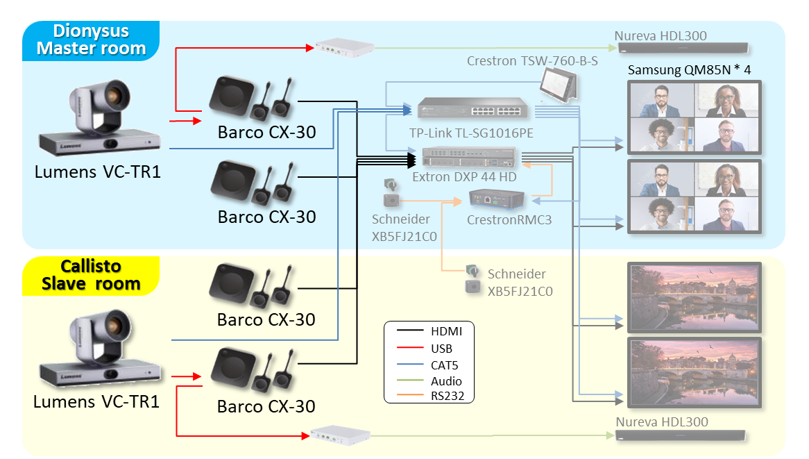
National Railway Company
Belgium
Success Stories
Government
Product: VC-TR1

Slide 5
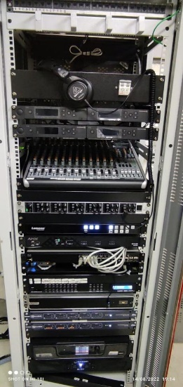

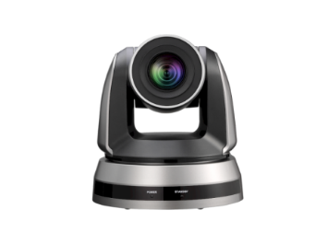
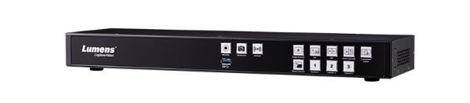
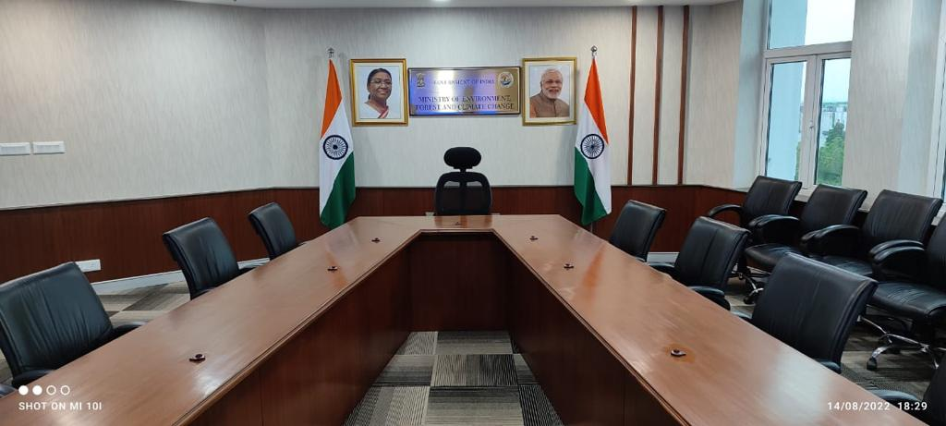
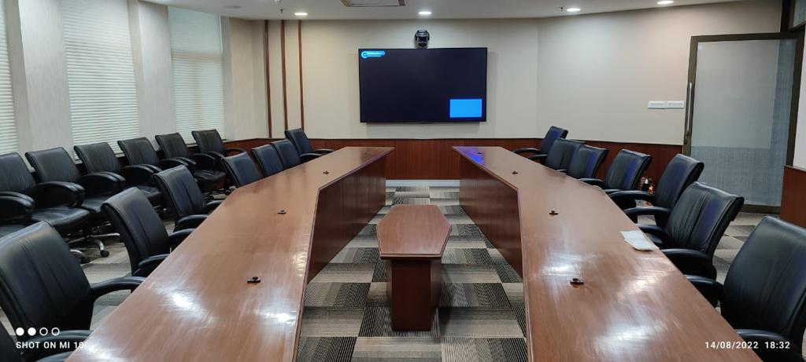
Ministry of Environment, Forest & Climate Change
- India
  Lumens Camera integrated LC200 & audio conference system for local recordings and online VC meetings.
Success Stories
Government
Product: VCA51P, LC200, AV Automation through AMX Controller

Slide 6
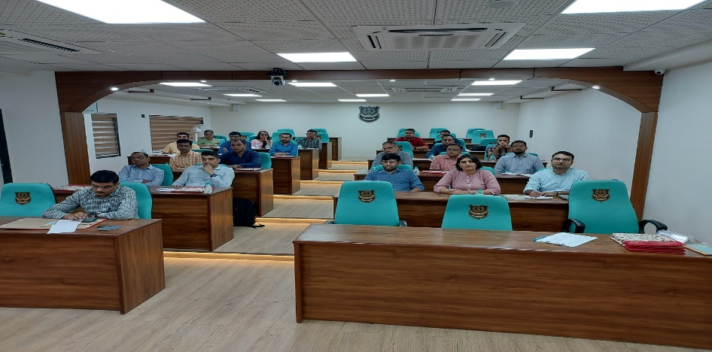
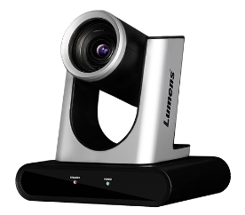
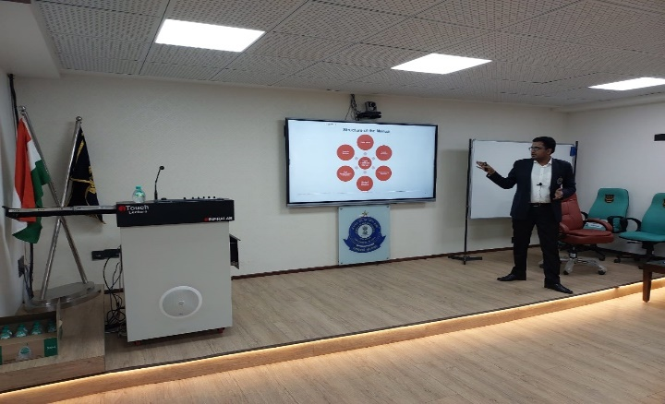

National Academy of Customs
India
Success Stories
Government
Product: VC-R30, LC200
  Application consist of VC calls and in house training for customs department officials along with recording the training material. Lumens was finalsed considering the quality and the recording solution along with switching of the cameras inputs.
“After seeing multiple demos of different OEM, Lumens product were finalized considering the product quality of the camera along with recording storage device and easy of operation to switch between 2 cameras.”
Mr. Ragi
Admin Head
National Academy of Customs Baroda Gujarat

Slide 7

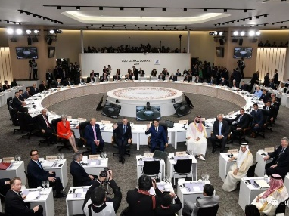
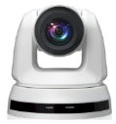

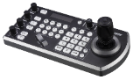

G20
Japan
Success Stories
Government
Product: VC-BR50P、VS-KB30
  G20 is an international forum of 19 countries and EU that together represent 90% of world economy. 2019 G20 Summit was held in Osaka, Japan.
  PTZ IP Cameras VC-A50P paired with IP Camera Controller are used to capture speakers and then broadcast and live streaming to facilitate language interpretation.
  Bosch DICENTIS, the world first IP-based conference system built on the OMNEO, together with Lumens IP Cameras VC-A50P that providing live feeds orchestra the international summit conference solution.
“Lumens VC-A50P PTZ camera was chosen due to its outstanding capability. The cameras were easy to install, supports PoE for long distance image/sound transmission and offers a nice image quality. The newly released IP camera controller also satisfies the need of control in order to broadcast the videos,”
Hideki Utsugi
Manager of Network Solution Business Unit, MTC Japan
Notes:
\\fae-nas\MKT\07 Ting Google Drive\07product support_02-case study\2.A50P-Bosch_gov_G20_002\Final

Slide 8
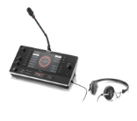
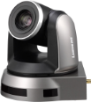


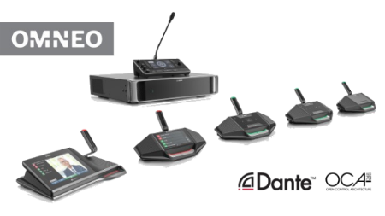





G20
Japan
Success Stories
Government
Product: VC-BR50P、VS-KB30
BOSCH DICENTIS
Interpreter Desk
Lumens PTZ Camera
VC-A50P
Lumens IP Controller
VS-KB30
Ethernet
Ethernet
Ethernet
Ethernet
Ethernet
Ethernet
Ethernet
Ethernet
Router
BOSCH DICENTIS
Powering Switch
Ethernet
RTSP/RTMP
BOSCH DICENTIS
Conference System
Streaming
Operator PC
Notes:
\\fae-nas\MKT\07 Ting Google Drive\07product support_02-case study\2.A50P-Bosch_gov_G20_002\Final

Slide 9
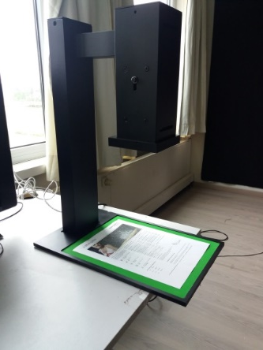
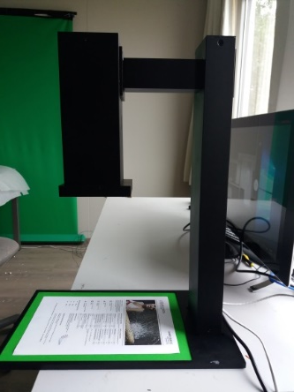

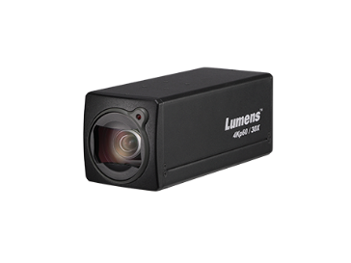
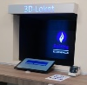







Police of Limburg
Belgium
Success Stories
Government
Product: VC-BC701P
  The police are using remote working stations where people can dial in from a remote location instead of being the police station in person.
  The Lumens box camera is used to scan the ID card and documents.
  Integrating with the VC software of Teleportel, the box camera can take high-resolution snapshots and transmit to the police officer through RTSP protocol. This all without storing these files on the far side to protect the privacy of the customer.
Internet
Teleportel
3D Kiosk
Router
Cat 5e/6
Internet
Lumens Box Camera
VC-BC701P
“This is the solution we need. We can now help a lot more people at a time that is better for them”
Police of Limburg

